Slide 1
Deep Motif Dashboard: Visualizing and Understanding Genomic Sequences Using Deep Neural Networks
Abhimanyu Banerjee
Junhong Choi
Raunaq Rewari
Wen Torng
Joy Xiang
Notes:
My name is Choi, and This is Ron, Abhi, Wen and Joy. Today we will present you Deep Motif Dashboard paper, and their attempt to visualize DNNs used on genomic sequences.

Slide 2
Can we predict genetic diseases from your DNA alone?
DNA sequences
Courtesy: National Human Genome Research Institute - Extracted image from http://www.genome.gov/glossary/resources/karyotype.pdf
Notes:
Previously in class, we have looked at methods such as DeepSEA and DanQ, which has one motivation. Given your sequences, which is really becoming cheap to get,

Slide 3
Can we predict genetic diseases from your DNA alone?
DNA sequences
Probability of genetic diseases
Copyright 2013 New York Times Company
Image from http://www.nytimes.com/2013/05/15/health/angelina-jolies-disclosure-highlights-a-breast-cancer-dilemma.html?action=click&contentCollection=Opinion&module=RelatedCoverage&region=EndOfArticle&pgtype=article
Courtesy: National Human Genome Research Institute - Extracted image from http://www.genome.gov/glossary/resources/karyotype.pdf
Notes:
Can you predict the risk of getting genetic diseases? For instance, say you found a variant in your genome, as Angelina Jolie did in her BRCA gene. Given that and other possible variants, how likely is for you to get a disease, like a breast cancer? To answer this, we need to understand how these variants work in our genome.

Slide 4
Making sense of the DNA
Coding region:
Codes for the shape/function of the protein
<2% of the human genome
Accounts for ~7% of disease-associated variants
Mutations are often deadly
Notes:
Our genome, like many other things, can be divided into two regions. First, coding region determine the shape and function of the protein, and variants occurring here should affect that. While we have a good idea of how these variants can lead to diseases, this is also very small part of the genome.

Slide 5
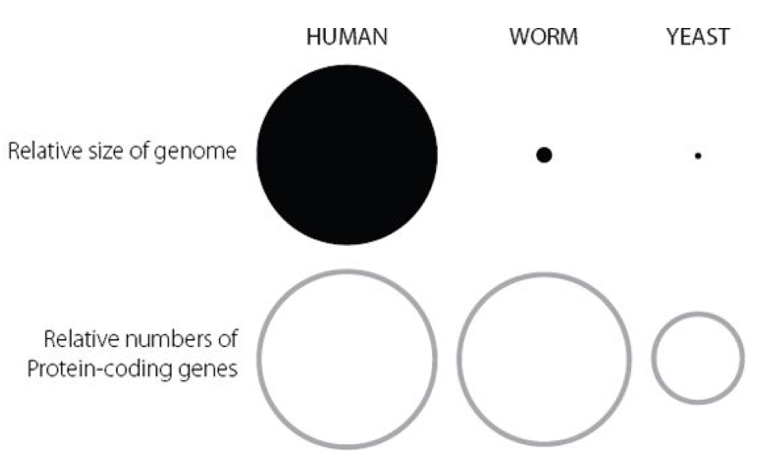
Making sense of the DNA
Coding region:
Codes for the shape/function of the protein
<2% of the human genome
Accounts for ~7% of disease-associated variants
Mutations are often deadly
Relative numbers
of coding genes
Human
Worm
Yeast
(Adapted from Figure 3.1 of Junk DNA: A Journey Through the Dark Matter of the Genome, Nessa Carey)
Notes:
In fact, if we are just comparing the number of genes in this region, we are not that different from worms.

Slide 6
Making sense of the DNA
Coding region:
Codes for the shape/function of the protein
<2% of the human genome
Accounts for ~7% of disease-associated variants
Mutations are often deadly
Non-coding region:
>98% of the human genome, but we really don’t know what most of its doing.
Some codes for which, when and how much of proteins are made, by controlling Transcription Factor (TF) binding.
Relative numbers
of coding genes
Human
Worm
Yeast
(Adapted from Figure 3.1 of Junk DNA: A Journey Through the Dark Matter of the Genome, Nessa Carey)
Notes:
The other part, non-coding region, is much larger.

Slide 7
Making sense of the DNA
Coding region:
Codes for the shape/function of the protein
<2% of the human genome
Accounts for ~7% of disease-associated variants
Mutations are often deadly
Non-coding region:
>98% of the human genome, but we really don’t know what most of its doing.
Some codes for which, when and how much of proteins are made, by controlling Transcription Factor (TF) binding.
Relative numbers
of coding genes
Human
Worm
Yeast
Relative size of genome
(Adapted from Figure 3.1 of Junk DNA: A Journey Through the Dark Matter of the Genome, Nessa Carey)
Notes:
When you make the same comparison across these three organisms on the size of non-coding region, you can almost say this is what makes us human and what makes worm a worm.
However, it also is more mysterious. We don’t know much about this region, but we know that some parts within this region controls for which and when and how much of proteins are made, by controlling TF binding to the beginning of the coding region.

Slide 8
DNNs can improve our prediction
(Zhou and Troyanskaya, Nature Methods 2016)
Notes:
What others have previously argued is that using DNNs, and available data such as ChIP-seq and DNAse-seq, we can make a good prediction for TF binding just from your DNA sequences alone, which may lead to different functionality of genes we see in genetic diseases.

Slide 9
DNNs can improve our prediction
(Zhou and Troyanskaya, Nature Methods 2016)
(Quang and Xie, NAR 2016)
Notes:
Using different architectures, as in DeepSEA and DanQ, we can improve this and improve it to quite well.

Slide 10
DNNs can improve our prediction
But we don’t know how DNNs made these predictions
(Zhou and Troyanskaya, Nature Methods 2016)
(Quang and Xie, NAR 2016)
Notes:
But one problem is that we don’t know how DNNs come to this conclusion.

Slide 11
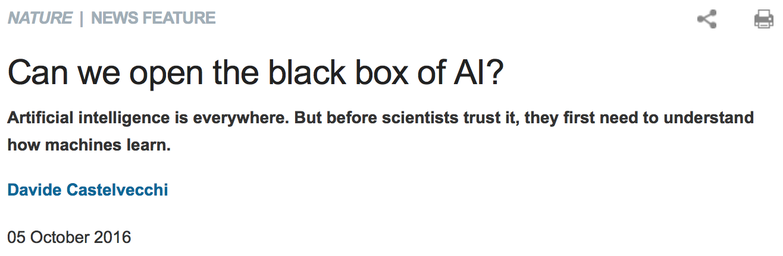
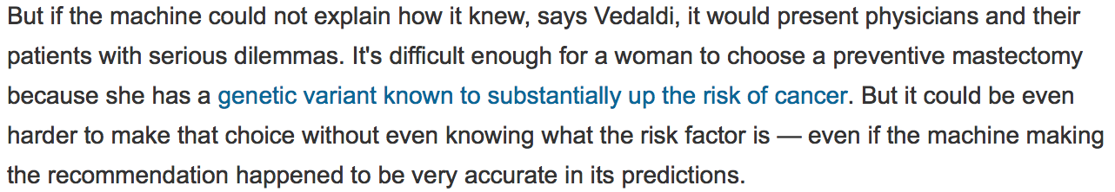
Notes:
Some say this isn’t much of a problem, but some are very worried about this ”blackbox” problem. This article from Nature few weeks ago sums this concern quite well.

Slide 12
Limited training / validation sets cannot guarantee how individual cases may differ
Notes:
Due to limited training and validation sets leading to overfitting issues, we cannot really guarantee how general DNN prediction would be. This is a problem for the end users, such as medical doctors and REALLY, the patients, who have to make LITERALLY a life-and-death decision based on the output of DNNs.

Slide 13
Opening the Blackbox: Visualizing DNNs’ thinking process
DNN
DNA sequences
Probability of genetic diseases
Courtesy: National Human Genome Research Institute - Extracted image from http://www.genome.gov/glossary/resources/karyotype.pdf
Copyright 2013 New York Times Company
Image from http://www.nytimes.com/2013/05/15/health/angelina-jolies-disclosure-highlights-a-breast-cancer-dilemma.html?action=click&contentCollection=Opinion&module=RelatedCoverage&region=EndOfArticle&pgtype=article
(Lanchantin et al, arXiv)
Notes:
One way to resolve this issue is to visualize how DNN made this decision.

Slide 14
Opening the Blackbox: Visualizing DNNs’ thinking process
DNN
DNA sequences
Probability of genetic diseases
Courtesy: National Human Genome Research Institute - Extracted image from http://www.genome.gov/glossary/resources/karyotype.pdf
Copyright 2013 New York Times Company
Image from http://www.nytimes.com/2013/05/15/health/angelina-jolies-disclosure-highlights-a-breast-cancer-dilemma.html?action=click&contentCollection=Opinion&module=RelatedCoverage&region=EndOfArticle&pgtype=article
(Lanchantin et al, arXiv)
DeMo Dashboard
Notes:
In this line, today’s paper, Deep Motif Dashboard or DeMo Dashboard, will talk about its attempts to visualize the thinking process of DNNs that are out there, such as DeepSEA and DanQ.

Slide 15
Outline of the paper
Structure of DNNs used
Visualizing DNNs using “Saliency Map”
Visualizing temporal components of RNN
Notes:
To explain this paper well, we have divided rest of our presentation into three parts: First, we will show the structure of DNNs used to generate the prediction.

Slide 16
Outline of the paper
Structure of DNNs used
Visualizing DNNs using “Saliency Map”
Visualizing temporal components of RNN
Notes:
Second, we will show how the use of their version of saliency map aids visualizing DNNs’ thought process.

Slide 17
Outline of the paper
Structure of DNNs used
Visualizing DNNs using “Saliency Map”
Visualizing temporal components of RNN
Notes:
Third, we will show how they tackled the problem of visualizing temporal aspect of RNN, as saliency map cannot be easily used for this. With this, I will pass the talk to Ron.

Slide 18
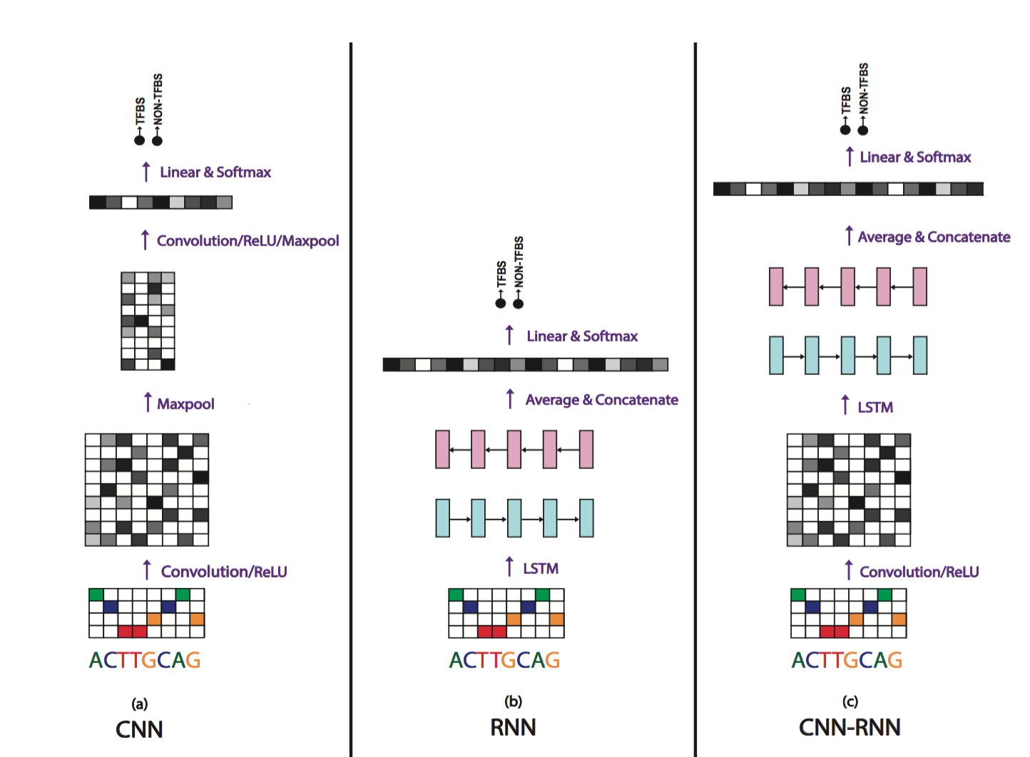
Models Used

Slide 19
Dataset
Number of TFs used: 108 (from ENCODE); 1 dataset per TF
Input sequence length: 101
Average number of training examples per dataset: ~30,000 (balanced between + and -)
Number of testing examples per dataset: 1,000 (balanced between + and -)
Positive examples: centered on ChIP-Seq peak
Negative examples: generated by dinucleotide-preserving shuffle of positive examples
16 Di-nucleotides
Prevents reliance on low-level statistics

Slide 20
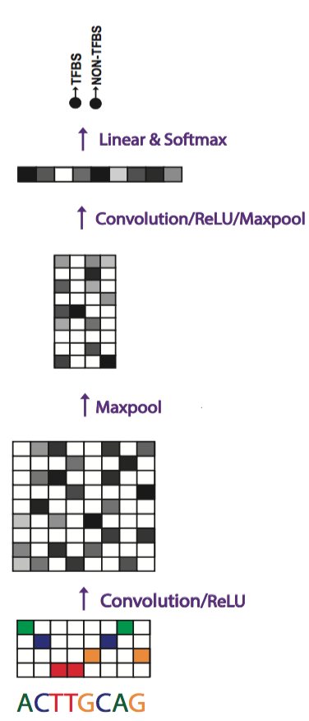
CNN
Conv/ReLU/MaxPool/Dropout = 1 layer
3 in total
+ Dropout
Caveat: Max-pooling too early
Model Parameters
Dropout: 0.5
Size of kernel: 9-5-3
Number of filters: 128
Pooling size: 2x2
Batch Size: 256
Learning Rate: 1e-2
Optimization schedule: Adam

Slide 21
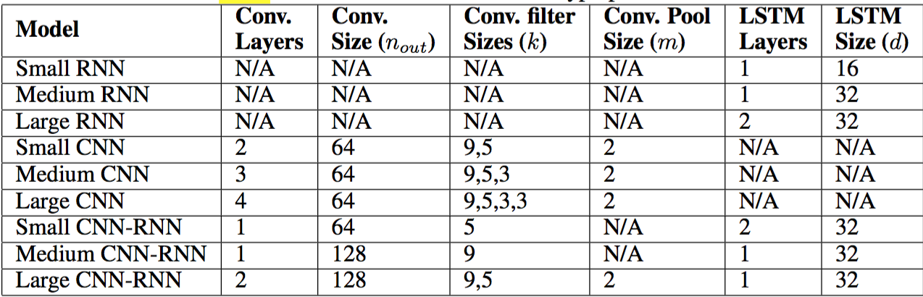
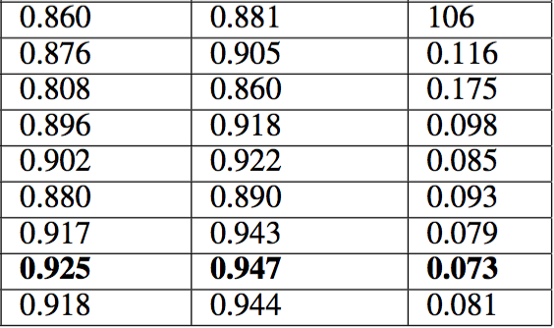
Increasing Depth doesn’t help

Slide 22
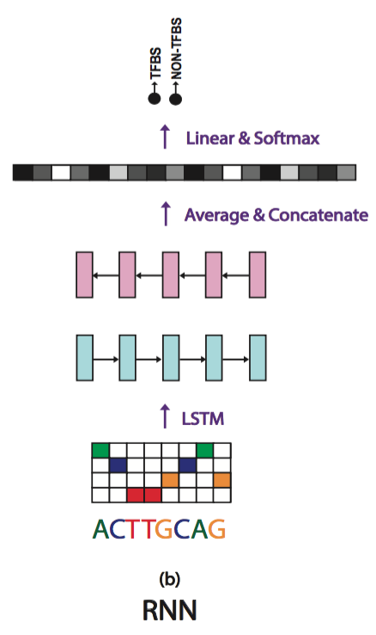
RNN
Bi-directional LSTM. Different from DanQ?

Slide 23
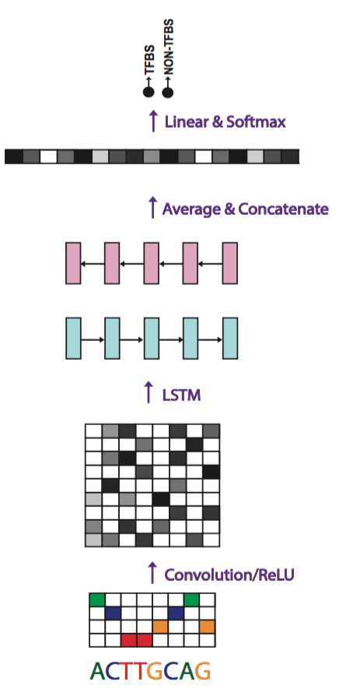
CNN + RNN
NOTE: No max-pooling here

Slide 24
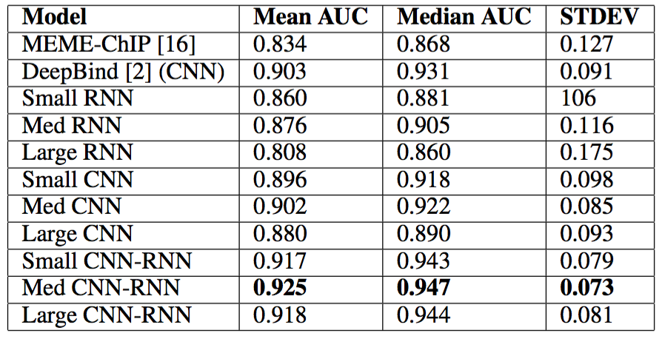
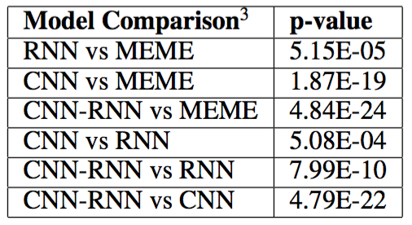
CLAIM
“experimental results indicate that a convolutional-recurrent architecture performs the best among the three architectures”

Slide 25
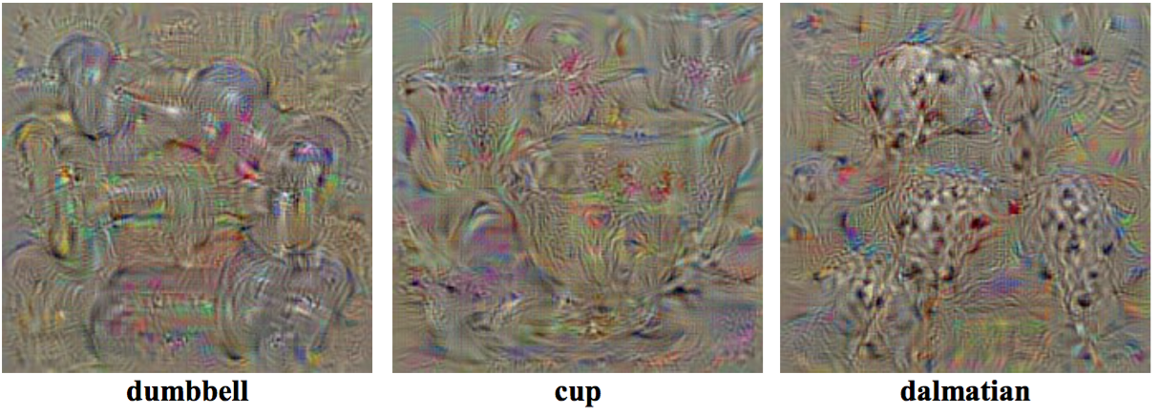
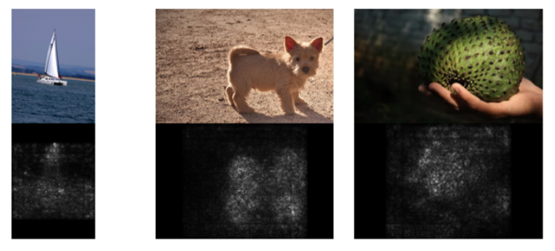
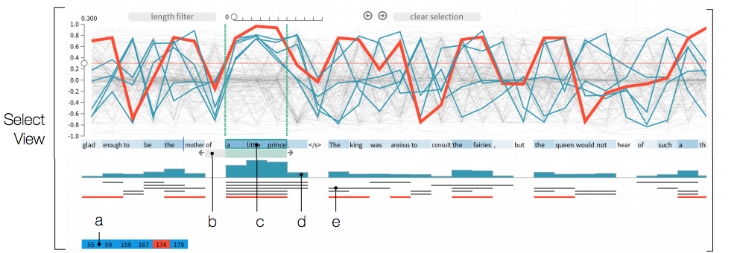
Visualization methods in computer vision
Class optimization
Saliency maps
Visualizing temporal dependencies RNN
Deep Inside Convolutional Networks: Visualising Image Classification Models and Saliency Maps (Simonyan et al)
(Simonyan et al)
Visual Analysis of Hidden State Dynamics in Recurrent Neural Networks. (Strobelt et al)

Slide 26
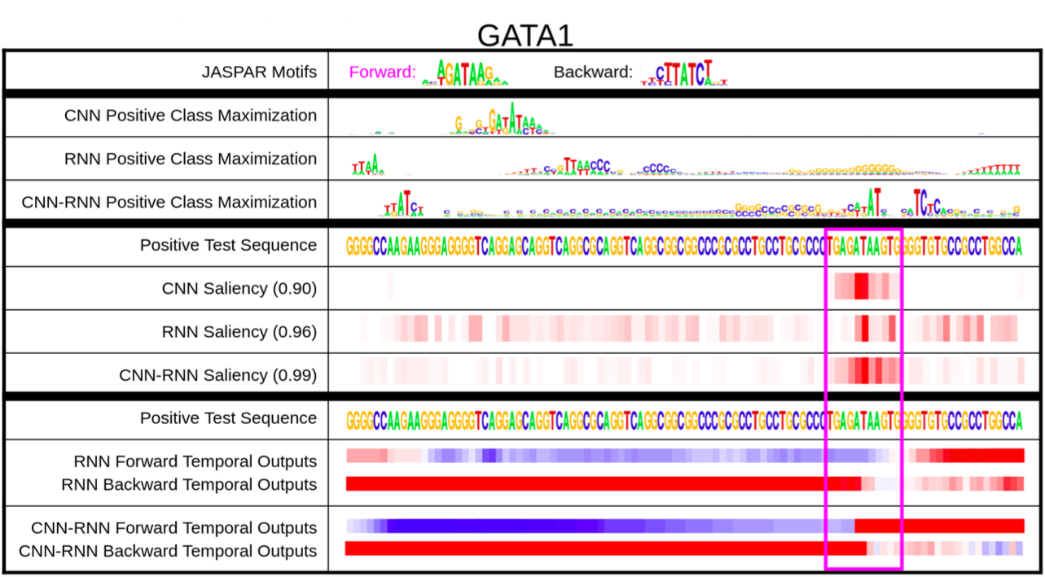
Making sense of model predictions with Deep Motif (DeMo) Dashboard
Class optimization
Saliency maps
Temporal output scores
Notes:
Once we have our trained models to predict binding sites, the second step of our approach is to understand why the models perform the way they do. As explained in section 3, we do this by introducing three different visualization strategies for interpreting the models:
1. Measuring nucleotide importance with Saliency Maps.
2. Measuring critical sequence positions for the classifier using Temporal Output Scores. 3. Generating class-specific motif patterns with Class Optimization.

Slide 27
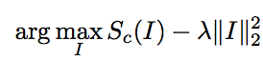
Class optimization in image
These images are synthetically generated to maximize class score in a Deep Neural Network (DNN).
Notes:
Optimize the input pixels
where λ is the regularisation parameter. A locally-optimal I can be found by the back-propagation method. The procedure is related to the ConvNet training procedure, where the back-propagation is used to optimise the layer weights. The difference is that in our case the optimisation is performed with respect to the input image, while the weights are fixed to those found during the training stage. We initialised the optimisation with the zero image (in our case, the ConvNet was trained on the zero-centred image data), and then added the training set mean image to the result. The class model visualisations for several classes are shown in Fig. 1. It should be noted that we used the (unnormalised) class scores Sc, rather than the class posteriors, returned by the soft-max layer: Pc = Pexp Sc c exp Sc . The reason is that the maximisation of the class posterior can be achieved by minimising the scores of other classes. Therefore, we optimise Sc to ensure that the optimisation concentrates only on the class in question c. We also experimented with optimising the posterior Pc, but the results were not visually prominent, thus confirming our intuition.

Slide 28
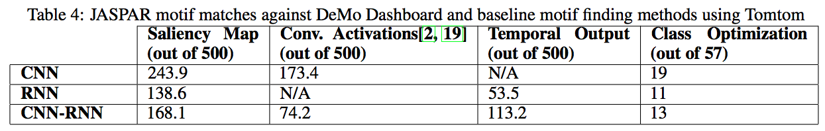
Class optimization in TFBS classification
Not really interpretable?
Notes:
We find a locally optimal X through stochastic gradient descent,

Slide 29
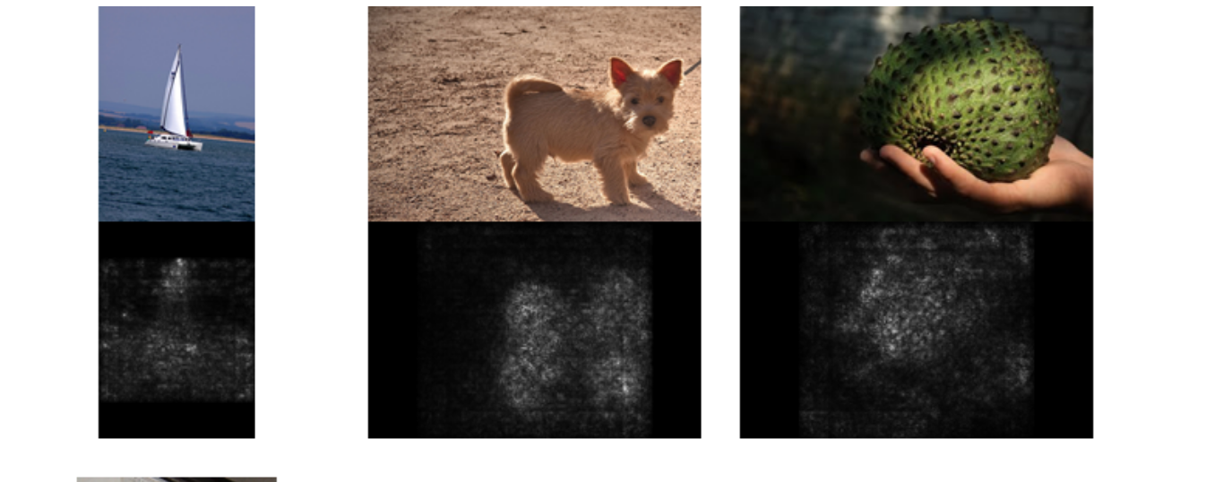
Important features Learnt from Saliency Maps
Learning what parts of the image are most important for the classification problem.
Approaches: Perturbative approach(mutation maps in Deep Bind) Change a single nucleotide and see the change in score
Perturbative approaches are slow ...use gradients!
Notes:
A Saliency map tries to learn which pixels are most important in classifying an image.
A Saliency map computes the derivative of the scoring function with respect to the input evaluated
at a fixed image. It tells us which pixels are more relevant in deciding the output score function .
In the field of vision, saliency maps have been used for object localization.

Slide 30
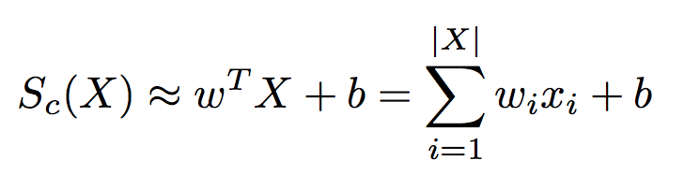
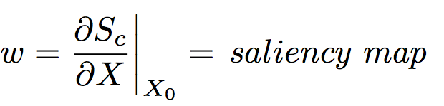
Saliency Maps: detail of what the authors did
Rank nucleotides based on their influence on the score
Non-linear score approximated with linear function
gradient
saliency score generally used = gradient
saliency score here = gradient • one-hot encoding input
The saliency map is a more mathematically sound approach than what is done in Deep Bind(In silico mutagenesis) which is a perturbative approach
Notes:
To go into the math a little more, think of the scoring function to be a highly non linear function of the input. We can locally approximate it to be linear, near a particular sequence and do a taylor expansion.
The Saliency map computes a gradient of the Score with respect to the sequence vector computed at a particular sequence. This is calculated by
backprop. It gives us information on which position is more important than other positions. A similar perturbative approach was used to compute mutation maps in the deep bind paper
reference DeepLIFT: Saliency maps (Simonyan et al) use gradient from backpropagation on inputs (instead of weights for actual backpropagation)

Slide 31
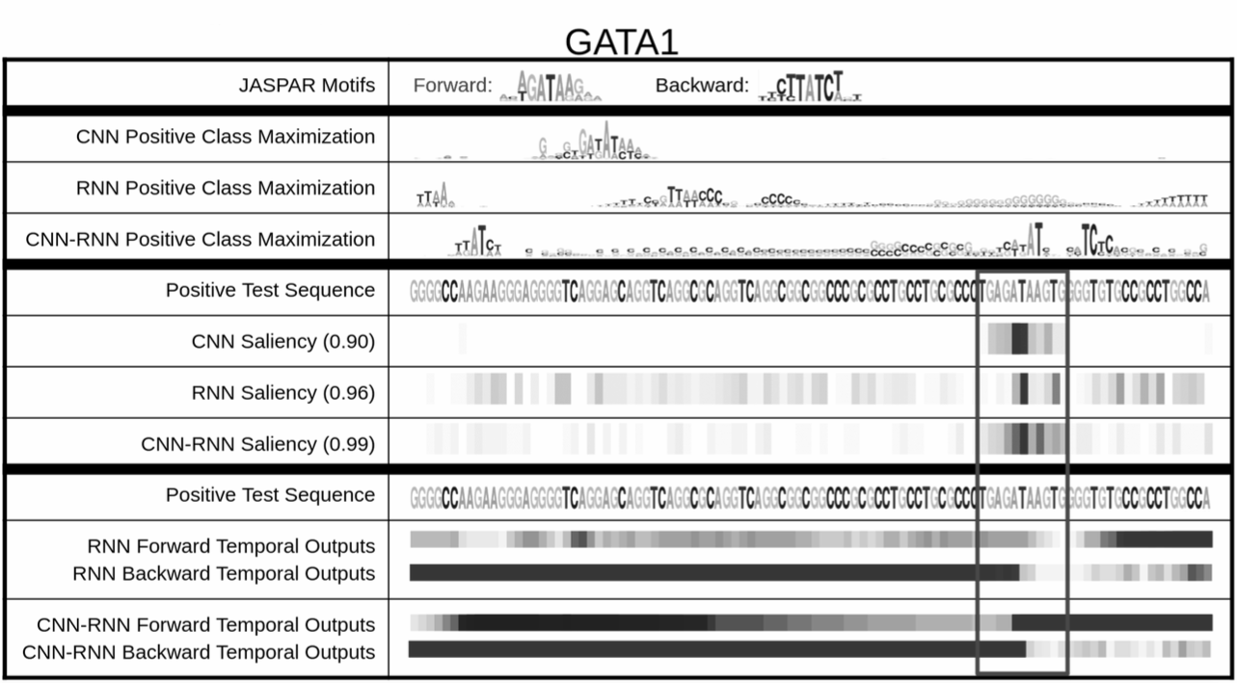
Interpretations of model that can be drawn from saliency maps
To automatically detect motifs, a 9 mer with the largest saliency score is selected
Notes:
THe Jaspar MOTIF TAGATAATG has been shown here.
If you looka t the saliency map you see the motif lit up in all the three cases. The CNN is best at motif detection..whicle RNN s are good at looking for motif grammars and look at longer range features.

Slide 32
Discussion of Saliency maps
Gradient*input
The absolute value of the derivative is added up within a window of 9 to compute a saliency score.
This method might not be great in picking up two different motifs
Notes:
reference DeepLIFT: Saliency maps (Simonyan et al) use gradient from backpropagation on inputs (instead of weights for actual backpropagation)

Slide 33
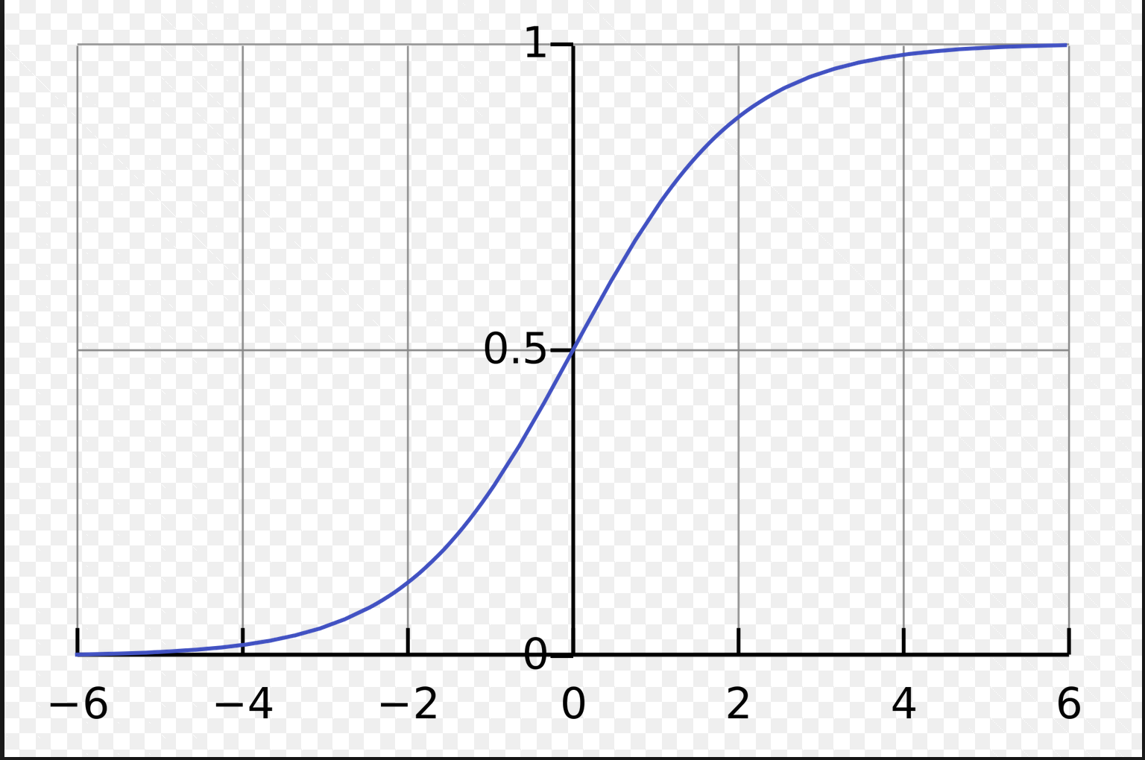
Saturation problem of gradient based visualization method
Gradient based method can run into saturation problems
Get around this suggested by Deep Lift
Notes:
reference DeepLIFT: Saliency maps (Simonyan et al) use gradient from backpropagation on inputs (instead of weights for actual backpropagation)
I now pass the microphone to Wen, who will tell us about the temporarl models

Slide 34
How Informative are Saliency maps for RNN Models?
RNNs are
Intrinsically recurrent
Highly non-linear class score functions
Saliency Maps : Local gradient based method
Notes:
Thank you abhi for introducing the saliency method in details. As my colleges have previously mentioned, the saliency method has been recognized as a successful visualization method for CNNs and image tasks in general.
Because of the intrinsic recurrent nature of RNNs, the class score function can be much more highly non-linear with respect to each input. It is unclear as how well these local gradient based methods work for RNNs

Slide 35
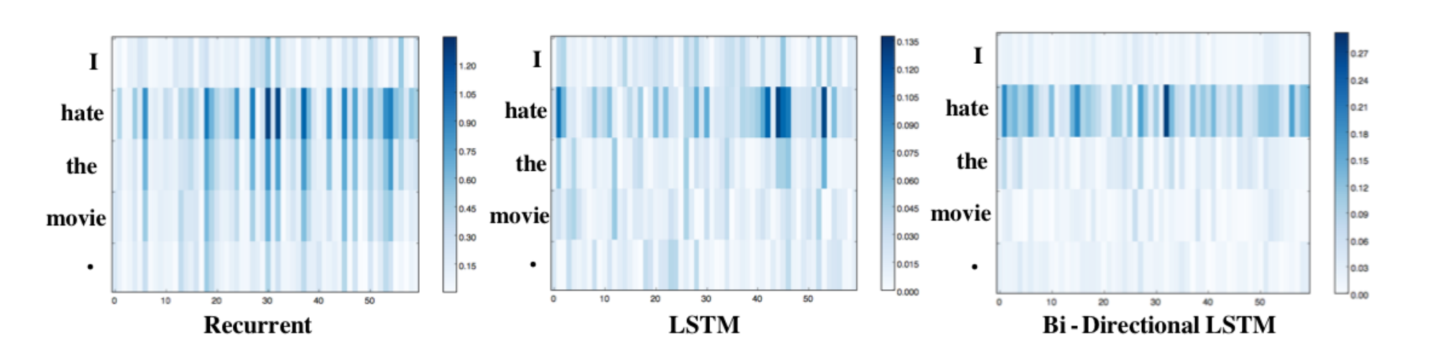
Saliency Heatmap of RNN Models in NLP Visualizing and Understanding Neural Models in NLP (Li et al. 2016)
Task : Classifying sentences as positive or negative reviews
Example: I hate the movie
True Label : Negative
Word representation vector (dim:60)
Predicted Label : Negative
Predicted Label : Negative
Predicted Label : Negative
Notes:
In this paper: Visualizing and Understanding Neural Models in NLP, the authors built different recurrent networks to predict if each given sentence is a positive or negative review and tried different methods to interpret what the networks have learned.
They similarly calculated the saliency maps for each network, where here they use a 60 dimension vector to represent each word, shown as the x-axis, and the y axis are different words. The heap-map color shows the importance of each word calculated from the saliency map. For example, for the sentence, I hate the movie, all networks have a high saliency score at the word “hate” and were all able to classify the sentence as very negative

Slide 36
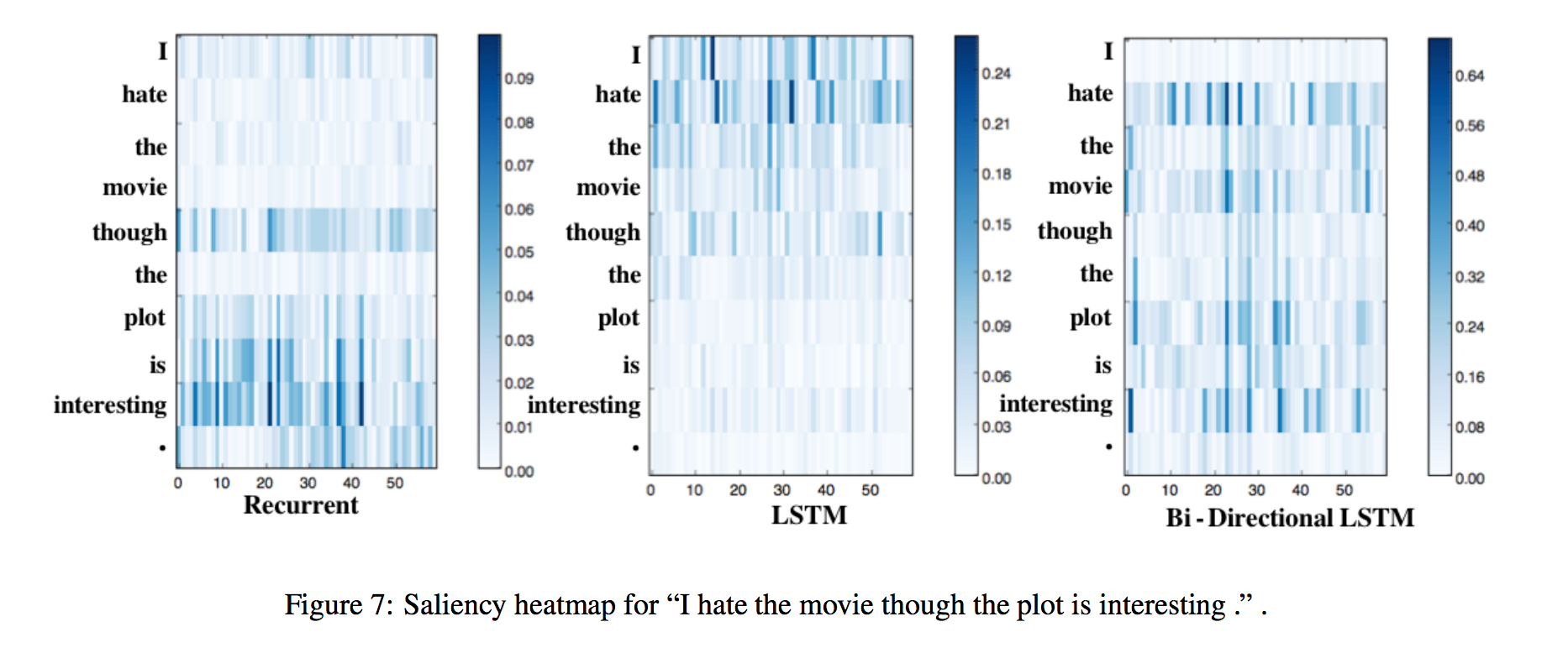
Saliency Heatmap of RNN Models in NLP Visualizing and Understanding Neural Models in NLP (Li et al. 2016)
Task : Classifying sentences as positive or negative reviews
Example: I hate the movie though the plot is interesting.
negative
positive
True Label : Negative
Notes:
However, for the sentence “I hate the movie though the plot is interesting”. Things get more interesting. At the first glance, it seems like simple RNNs suffer from the vanishing gradient problem and only put high weights on the second “” positive part ” of the sentence while LSTMs were able to pick up the negative key words and we would expect the simple RNNs to wrongly classify the sentence as positive

Slide 37
Saliency Heatmap of RNN Models in NLP Visualizing and Understanding Neural Models in NLP (Li et al. 2016)
Task : Classifying sentences as positive or negative reviews
Example: I hate the movie though the plot is interesting.
True Label : Negative
Notes:
However, for the sentence “I hate the movie though the plot is interesting”. Things get more interesting. At the first glance, it seems like simple RNNs suffer from the vanishing gradient problem and only put high weights on the second “” positive part ” of the sentence while LSTMs were able to pick up the negative key words and we would expect the simple RNNs to wrongly classify the sentence as positive

Slide 38
The Saliency Heatmap might not be capturing the whole story… Visualizing and Understanding Neural Models in NLP (Li et al. 2016)
Task : Classifying sentences as positive or negative reviews
Example: I hate the movie though the plot is interesting.
True Label : Negative
Predicted Label : Negative
Predicted Label : Negative
Predicted Label : Negative
Notes:
However, for the sentence “I hate the movie though the plot is interesting”. Things get more interesting. At the first glance, it seems like simple RNNs suffer from the vanishing gradient problem and only put high weights on the second “” positive part ” of the sentence while LSTMs were able to pick up the negative key words and we would expect the simple RNNs to wrongly classify the sentence as positive

Slide 39
The Saliency Heatmap might not be capturing the whole story… Visualizing and Understanding Neural Models in NLP (Li et al. 2016)
Task : Classifying sentences as positive or negative reviews
Example: I hate the movie though the plot is interesting.
True Label : Negative
Example: though the plot is interesting.
Predicted Label : Positive
Notes:
However, for the sentence “I hate the movie though the plot is interesting”. Things get more interesting. At the first glance, it seems like simple RNNs suffer from the vanishing gradient problem and only put high weights on the second “” positive part ” of the sentence while LSTMs were able to pick up the negative key words and we would expect the simple RNNs to wrongly classify the sentence as positive

Slide 40
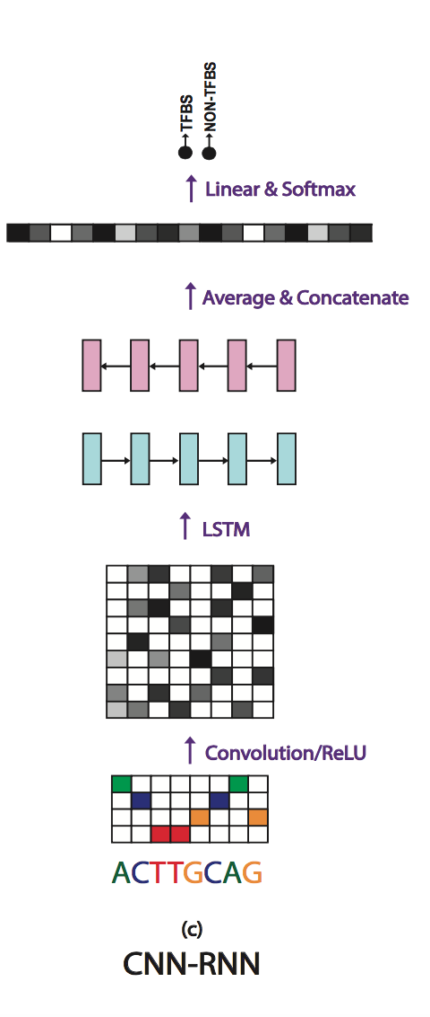
Temporal output scores
A A G C T G T C A G C A T T T G C T A A A
A

Slide 41
Temporal output scores
A A G C T G T C A G C A T T T G C T A A A
A
A A

Slide 42
Temporal output scores
A A G C T G T C A G C A T T T G C T A A A
A
A A
A A G

Slide 43
Temporal output scores
A A G C T G T C A G C A T T T G C T A A A
A
A A
A A G
A A G C

Slide 44
Temporal output scores
A A G C T G T C A G C A T T T G C T A A A
A
A A
A A G
A A G C
A A G C T

Slide 45
Temporal output scores
A A G C T G T C A G C A T T T G C T A A A
A
A A
A A G
A A G C
A A G C T
A A G C T G
A A G C T G T … N …

Slide 46
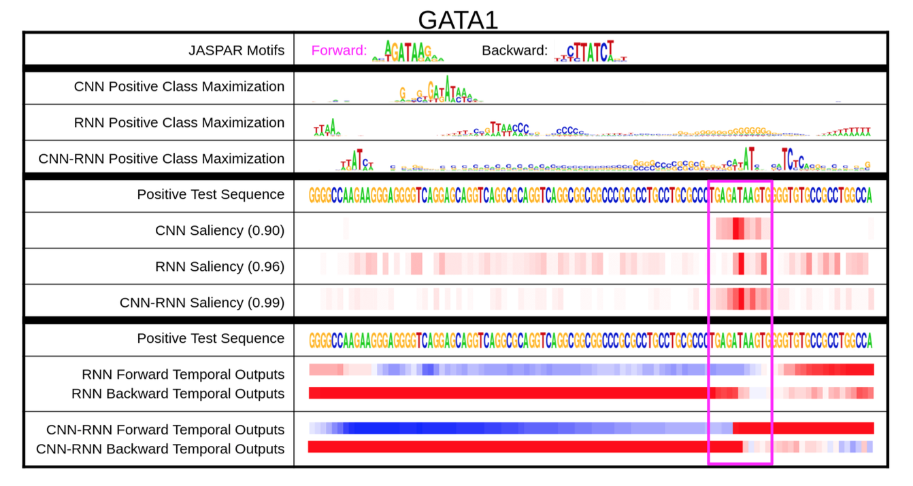
Well-defined motifs
Negative score
Positive score
Notes:
REFEReNCE FEI FEI LI PAPER, and other paper that visualizes RNN
What happens when there are multiple binding sites, and what happens when multiple sites are needed to be present at the same time?
There is no long distance dependency
A good visualization of RNN should capture information about the keep/forget gates

Slide 47
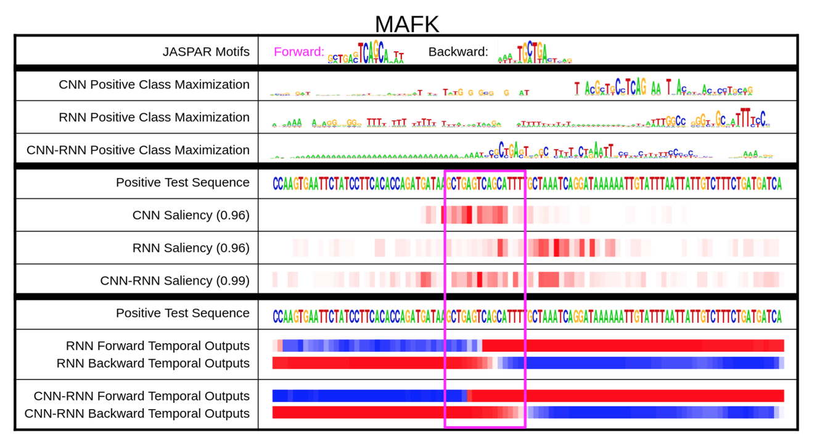
Well-defined motifs
Negative score
Positive score

Slide 48
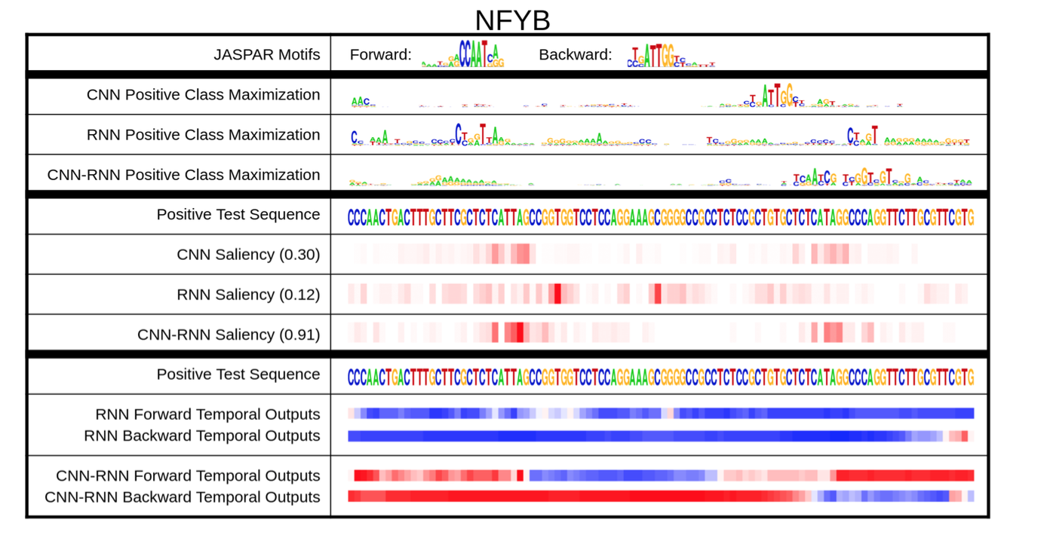
When the motif is less well-defined
Negative score
What’s happening here?
Positive score

Slide 49
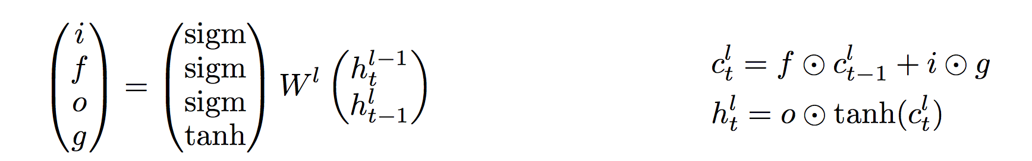
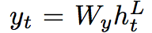
Limitations of temporal output scores?
What could happen when multiple sites are needed to be present at the same time?
Long range memory dependency might not be reflected in scores immediately
Forward
?
Backward
Memory cell
Hidden state
Output vector

Slide 50
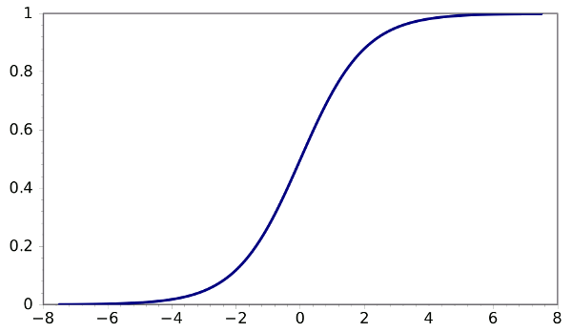
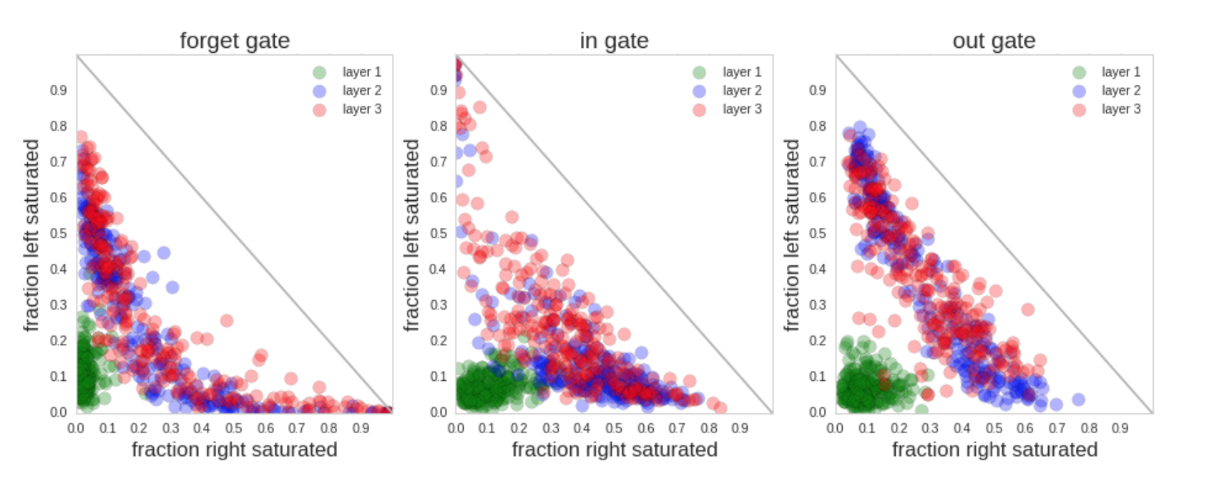
Gate activation statistics VISUALIZING AND UNDERSTANDING RECURRENT NETWORKS(Karpathy et al. 2015)
Right Saturated
Left Saturated

Slide 51
Gate activation statistics VISUALIZING AND UNDERSTANDING RECURRENT NETWORKS(Karpathy et al. 2015)
Right Saturated
Left Saturated
Long range memory

Slide 52
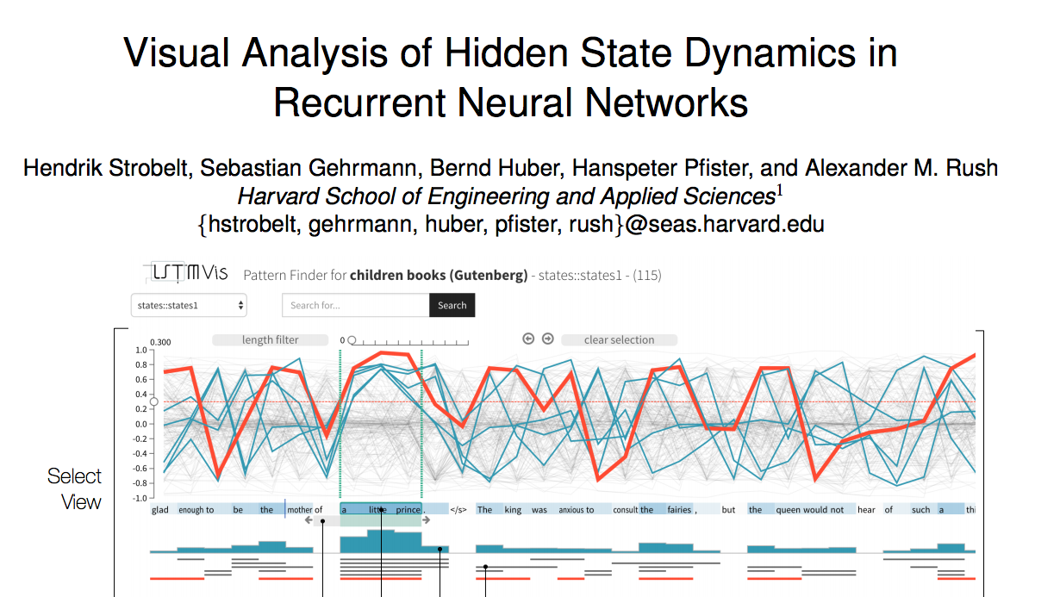

Slide 53
Conclusions
Saliency maps are reasonable for visualizing sequence motifs, especially for CNN, but may run into saturation problems
Temporal output is a simple implementation for representation sequential information, but may be insufficient for representing long range dependencies

